Slide 1
Adjudicator Training Seminar

Slide 2
Overview
Philosophy
Adjudication demonstration
Practice navigating www.ctfest.net
Practice adjudicating
Concluding remarks
Register to judge on CTFest

Slide 3
Philosophy
Assess/evaluate auditions
Provide students with positive, enriching experience
Provide objective, consistent, and accurate feedback
Notes:
3
The purpose of adjudicating is to EVALUATE the performances of students for the purpose of accurately placing them in or disqualifying them from an all-state or regional performing organization.
In this training session we learn to assess what students do in the audition, being as ACCURATE, OBJECTIVE, and CONSISTENT as possible.
Applying our own standards and expectations onto our assessment of students is unfair, since it cannot possibly be CONSISTENT with what other adjudicators are doing.

Slide 4
Philosophy
Applying our own standards and expectations onto our assessment of students is unfair, since it cannot possibly be CONSISTENT with what other adjudicators are doing.
Notes:
4

Slide 5
Professional Expectations
Judge fairly, consistently, and without bias
Prepare and know the music
Treat students with care, kindness & support, but do not “chat” with the students
Follow all given procedures, and accurately complete all sections
Never judge one’s own students
Notes:
5

Slide 6
Professional Expectations
Keep all auditions & names confidential
Make clear scores and comments
Positive first, then prescriptive-specific and of good quality (no dress code)
Be on time and keep to the schedule
Voice & Jazz judges provide music source that is placed by the student
Judge provides pitch & metronome
Notes:
6

Slide 7
Policies
Students must provide an original of the music, unless playing from memory (no music required if memorized).
Pieces that are available on IMSLP will be indicated in advance; see slide 26 for info on different editions…
If playing with different bowings or articulations, a copy should be provided to the adjudicators, who will destroy that copy at the end of the festival.
Notes:
7

Slide 8
Audition Information
Where to find the following:
Instrumental requirements
Vocal Prompts
Region Auditions
All-State Auditions
Notes:
Amy is a clicker

Slide 9
MIDDLE SCHOOL
Same rules from High School apply for Middle School (no talking to students, be professional, etc.)
PLEASE BE KIND—judge them as middle school students with that level of playing ability and tone quality in mind.

Slide 10
Middle School Rubrics
The middle school rubrics are available on the cmea.org website under the Auditions & Festivals Tab. Review prior to adjudication day.
PLEASE BE KIND—this is the first audition for many of these students and they are petrified!

Slide 11
RUBRICS, p. 8
Must have specific, clear descriptors
Must reflect desired weighting between the various items
Must clearly differentiate between individual students’ performances

Slide 12
RUBRICS, cont.d
You must pick the descriptor that most closely describes what you are HEARING.

Slide 13
RUBRICS, cont.
It is far more important that you focus on the DESCRIPTOR, than on the score attached to it.

Slide 14
RUBRICS, cont.
Rubric Parts
Rubric Procedures
YOU MUST STAY ON TIME!!

Slide 15
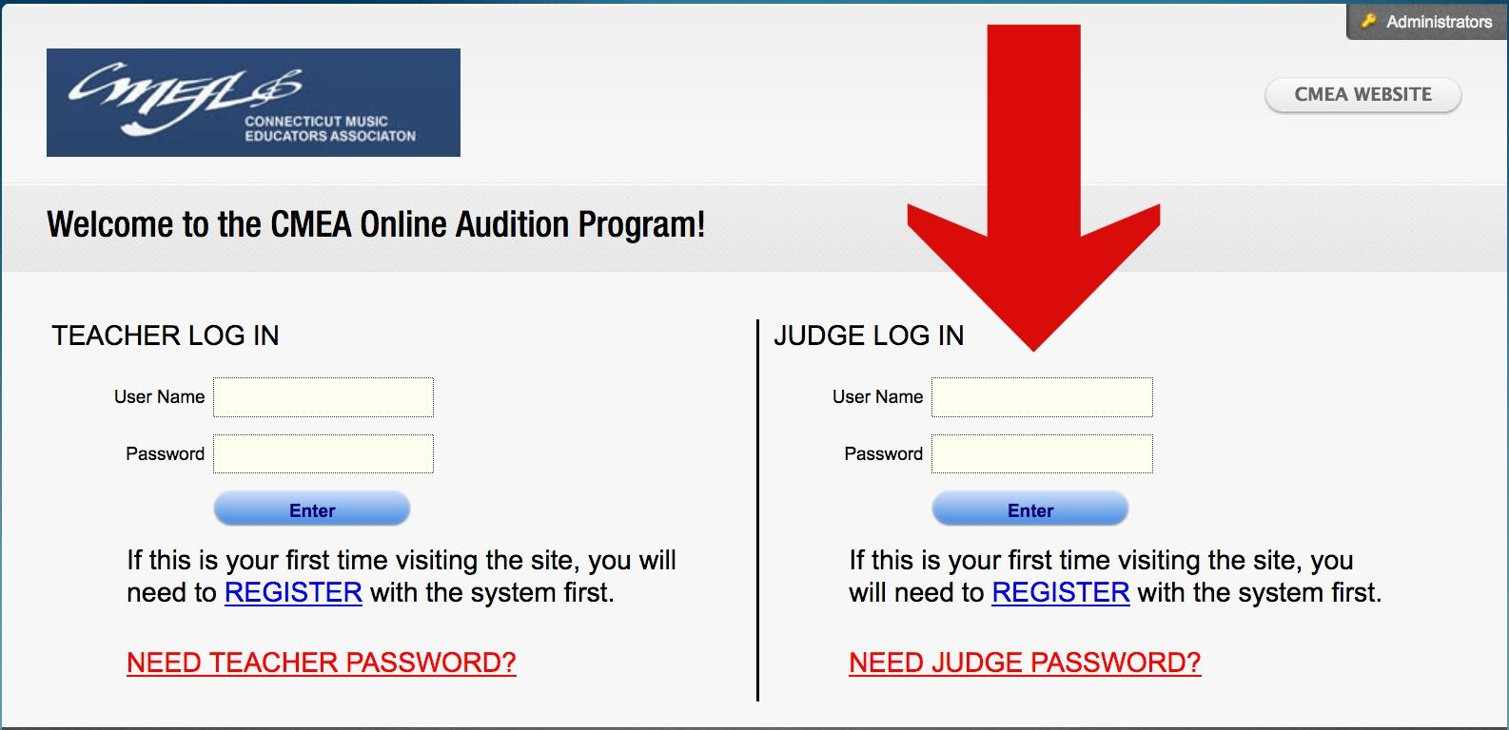
Creating a Judge Account on CTFest
www.ctfest.net Help Worksheet
Notes:
There are two sides to www.ctfest.net. Having a teacher account on ctfest.net and having a judge login are two separate accounts.
https://drive.google.com/file/d/15nvFWOx0RxLQEIq89pK6OzRYzxSHNL-k/view
Video Tour of CTfest

Slide 16
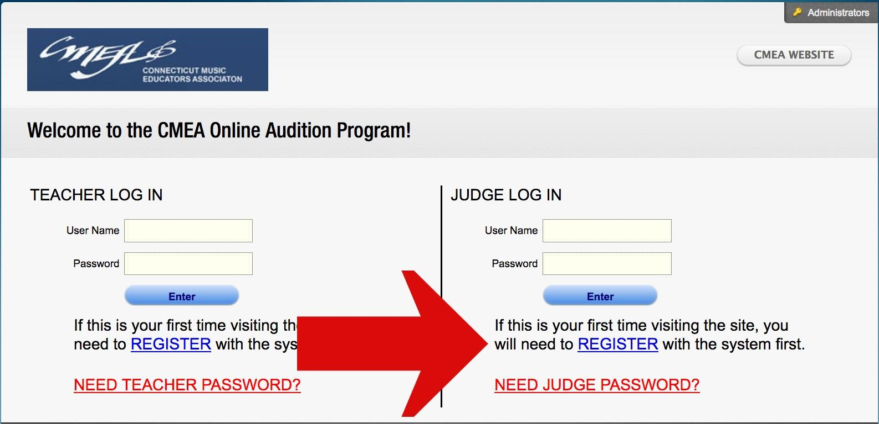
Register only the first time
Do not create multiple accounts!
If you need your password, please email one of the State Judge Chairs or press the red “Need Judge Password”

Slide 17
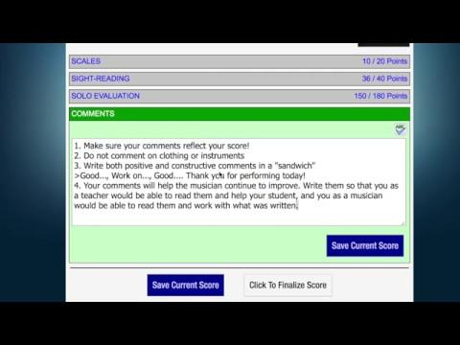

Slide 18
Information Button: Festival information, including which room you are judging. (Ex. Soprano Rm 2)
Map Button: Opens the location in Google Maps
Student List: List of performers for the day
Ok/Check Button: Click on this button to
accept your assignment. The button looks
like “ok” but changes to the “check box”
Thumbs Down Button: Declines the position. Please choose this option ASAP once you are assigned a position.
**PLEASE MAKE EVERY EFFORT NOT TO DECLINE ONCE YOU HAVE ACCEPTED!

Slide 19
Be Sure To:
Read informational email sent to judges
Check the list of students prior to the festival date.
You cannot adjudicate any student that you have/had as a student both publicly and privately, have coached, or interacted with.
Make Head Judge aware of conflicts the morning of the festival (during plenary).
Notes:
Student List-Check the list prior to the adjudication festival-make sure to let someone know the morning of if you are familiar with/had any of the students on the list. Head judge can make arrangements for you to switch rooms.

Slide 20
On Adjudication Day
Bring technology: laptop, tablet, speakers (jazz/voice), pen/pencil.
Arrival at the location for plenary session for start at 8am. (Breakfast/lunch provided!)
Check-in with chair/head judge - You will receive judge packet and room location.
Make sure you can connect to wifi.
Attend full plenary session.
Meet with head judges for individualized plenary.
Notes:
Note: You do not need to bring scratch sheets, solos, sight-reading, honorariums, etc. Will be provided for you. You can bring the solo for yourself if you have it.

Slide 21
What is the role of the head judge?
Help with technology/login issues.
Ensure that your scores are being recorded correctly.
Clarifying requirements and leading calibration of adjudicating during plenary.
Relay questions and concerns to the adjudication chairs, ensemble chairs, or region directors.
Fill in for you if a student you know or are familiar with is audition in your room.

Slide 22
During Your Group Plenary
Choose the scale(s) you will hear.
Plan sections of the solo(s) to hear (if time, plan to hear whole solo)
Practice adjudicating as a team (consistency)
Notes:
Note: You do not need to bring scratch sheets, solos, sight-reading, honorariums, etc. Will be provided for you. You can bring the solo for yourself if you have it.

Slide 23
Order of the Audition
Scale(s)
Solo
Sight-Reading
*Middle School audition requirements will vary

Slide 25
Judge Expectations
Make students feel welcome and comfortable; no comments about instruments, dress, etc.
Confirm the student’s name and record the student’s name on the scratch sheet.
Stay on schedule! If students are available early (and are willing), please take them.***
Only use the CMEA provided materials. Keep all audition materials/auditions confidential.
Please use the script provided. It is INAPPROPRIATE to give verbal feedback or a lesson/masterclass.
Score using CTFest.net AND fill in scratch sheets (one judge on each)
Scratch Sheets must be turned in at the end of the day.
Always click “Save Current Score”
Ask any questions immediately of head judges
Notes:
***If a student arrives early and you are free, offer the student the opportunity to take the audition. Remind students that they can audition early, but DO NOT HAVE TO!
Also, if a student is running late, you will still hear them. DO NOT comment on the student’s tardiness-you may be unaware of extended circumstances. Offer the student the chance to warm-up in the appropriate location if they seemed rushed and flustered. We want students to feel comfortable, safe, and focus on having a positive experience.
Scratch sheets are required. If you are two judges in a room, one can judge on ctfest.net and one on

Slide 26
Judge Expectations:
Solo Editions/Copyright
Every student will be heard:
The student may read off of a photocopy as long as he/she has an original in possession. If there is no original copy please write in the comments and alert a head judge/chair. Students without an original will still be scored.
If a student has a different edition, he/she may still audition and be scored; however, the score must reflect the comparison to the proper edition (different articulation, different octaves, etc. result in lower scores).
Students with the wrong solo may play and receive comments, but not receive a score for the solo. They may play and be scored on the scales and sight-reading.
Notes:
***If a student arrives early and you are free, offer the student the opportunity to take the audition. Remind students that they can audition early, but DO NOT HAVE TO!
Also, if a student is running late, you will still hear them. DO NOT comment on the student’s tardiness-you may be unaware of extended circumstances. Offer the student the chance to warm-up in the appropriate location if they seemed rushed and flustered. We want students to feel comfortable, safe, and focus on having a positive experience.
Scratch sheets are required. If you are two judges in a room, one can judge on ctfest.net and one on

Slide 27
Judge Expectations:
Comments
Be consistent and use the descriptors when adjudicating.
Be specific in comments such as “nice” tone, but be sure score reflects the comment. (Do not praise items you marked points off for)
P-C-P: Prescriptive, Constructive, Prescriptive
Avoid Generic Comments, Include feedback on what went well and how to improve if appropriate.
Notes:
***If a student arrives early and you are free, offer the student the opportunity to take the audition. Remind students that they can audition early, but DO NOT HAVE TO!
Also, if a student is running late, you will still hear them. DO NOT comment on the student’s tardiness-you may be unaware of extended circumstances. Offer the student the chance to warm-up in the appropriate location if they seemed rushed and flustered. We want students to feel comfortable, safe, and focus on having a positive experience.
Scratch sheets are required. If you are two judges in a room, one can judge on ctfest.net and one on

Slide 28
Good example of Comments
Poor example of Comments
Excellent preparation for the audition! Your level of musicianship was demonstrated through your attention to the details of the solo. Continue to build flexibility between your registers through continued work on long tones and harmonics. Make sure to check the key signature prior to starting the sight-reading, however great rhythmic accuracy in the sight-reading!
Good job today. Make sure to practice note accuracy. Make sure to dress appropriately for an audition. Good job with scale.
Notes:
*Make sure that what you write in the comments reflects your scoring. If you scored something low, make sure to choose that when writing comments. This helps the student, teachers, and parents understand the scoring.

Slide 29
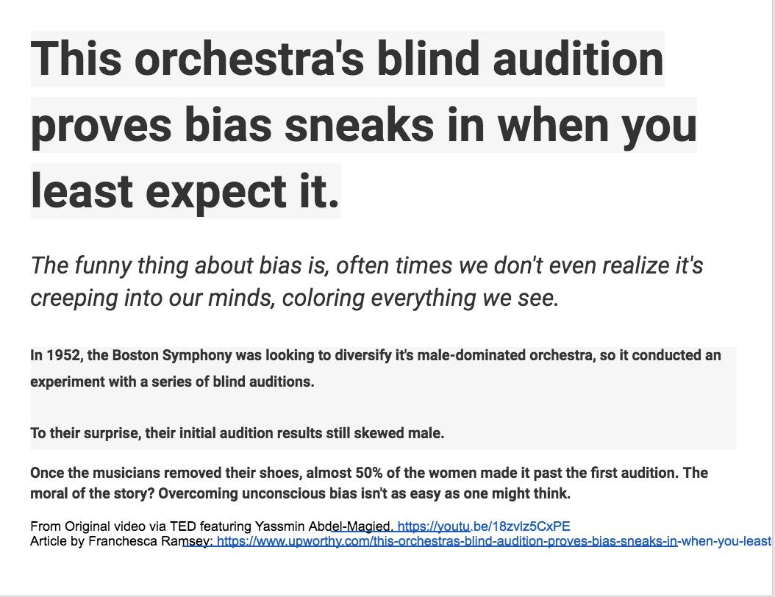
Notes:
https://www.youtube.com/watch?v=18zvlz5CxPE&feature=youtu.be

Slide 30
Notes:
https://medium.com/amplify/confronting-implicit-bias-a-remedy-for-the-public-health-issue-of-racism-9442578366cd

Slide 31
Notes:
http://kirwaninstitute.osu.edu/research/understanding-implicit-bias/

Slide 32
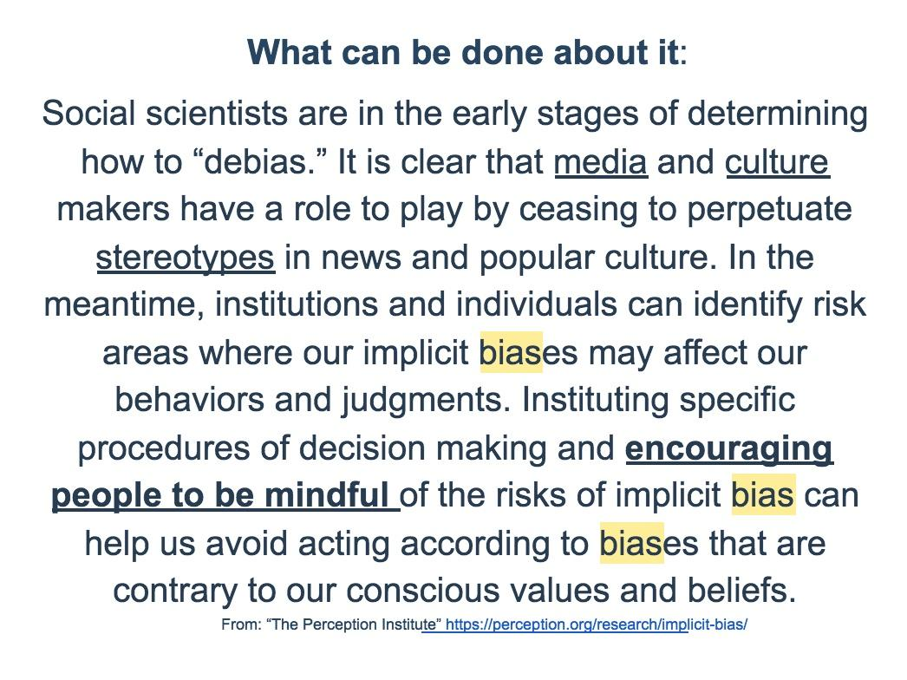
Notes:
https://perception.org/research/implicit-bias/

Slide 33
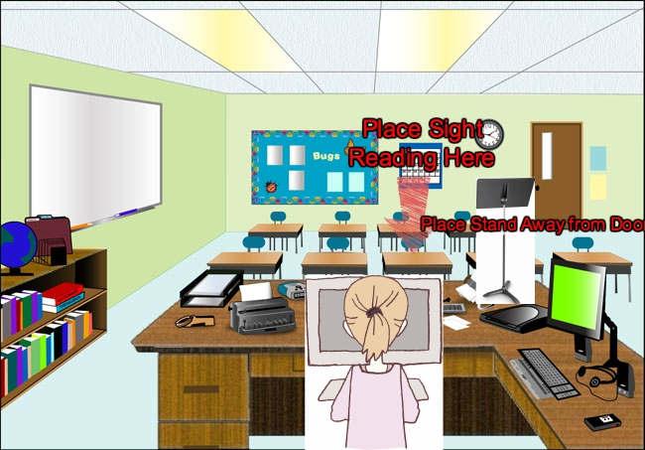
Room Setup
Notes:
Place stand facing away from the door.
Place yourself somewhere that you can see the door (in case of students trying to take pictures/keep an eye on the hallway)
Place sight-reading face down on a desk nearby.
Students except cello are expected to stand-please make chair available in case of extenuating circumstances.

Slide 34
Pre-Audition Checklist
1. Original of piece
2. Secure sight-reading excerpt
3. Make sure room has music stand, chair, metronome, (music source, speakers & pitch pipe in vocal rooms)
4. Set up area to be free of distractions
5. Make sure computer program works
Notes:
34

Slide 35
General Notes
High School Auditions are 12 minutes from entrance to exit. Try to allocate your time accordingly.
Middle School Auditions range from 11-14 minutes each.
Never leave materials unguarded--carry folder with sight-reading excerpt with you when both adjudicators leave the room
Runners and/or Head Judges will periodically check in—or find them if there is a problem
Notes:
35

Slide 36
Scoring Students
Remember to double check names.
Use the indicators when adjudicating-do not look at numbers.
Students should not receive 0’s unless something is not attempted.
Notes:
Video https://drive.google.com/file/d/179eq_gjrSP1gxVWGtRPpmQo0MlzLj61I/view SKip 42 to 47

Slide 37
Vocal Solo Audition
https://youtu.be/oHqtCA9khgc

Slide 38
Vocal Sight-Reading Audition
https://youtu.be/Dlmf2Kt0ETY

Slide 39
Violin Audition
https://youtu.be/VCxANhV9slA

Slide 40
Clarinet Audition
https://youtu.be/w8k8aeSh8vg

Slide 41
Tabulators
What is the role of the tabulator?
Monitor scoring
Consistency between homogenous rooms
Assists with check out
Ensure all rooms have comments/scores

Slide 42
Ending Tasks
Clean up room and put chairs back (as quietly as possible).
Fill out Honorarium
Turn in folder with original piece, sight-reading excerpt, & SCRATCH SHEETS.
Turn in Honorarium, check out with head judges/festival chair.

Slide 43
Honorariums
Honorariums are provided to you at the end of the festivals.
Also available at cmea.org under any festival tab, under “Judges Documents”
http://www.cmea.org/sites/default/files/sites/default/files/Adjudicator%20Honorarium%20Expense%20Sheet.pdf
Appropriately track your mileage. *If you don’t take mileage you can claim it on your taxes ($.30 versus $.50).
Notes:
43
Note: we do not hire undergraduate collegiate students. Judges must have a degree, teach, and/or be a practicing musician.

Slide 44
Questions?

Slide 45
Thank you!
Thanks so much for your willingness to help with adjudications. It really makes a difference for the students.
Good Luck!!

