Slide 1
Welcome to CMEA Region 2019 Auditions
Thank you for being here!
wifi –
Password -

Slide 3
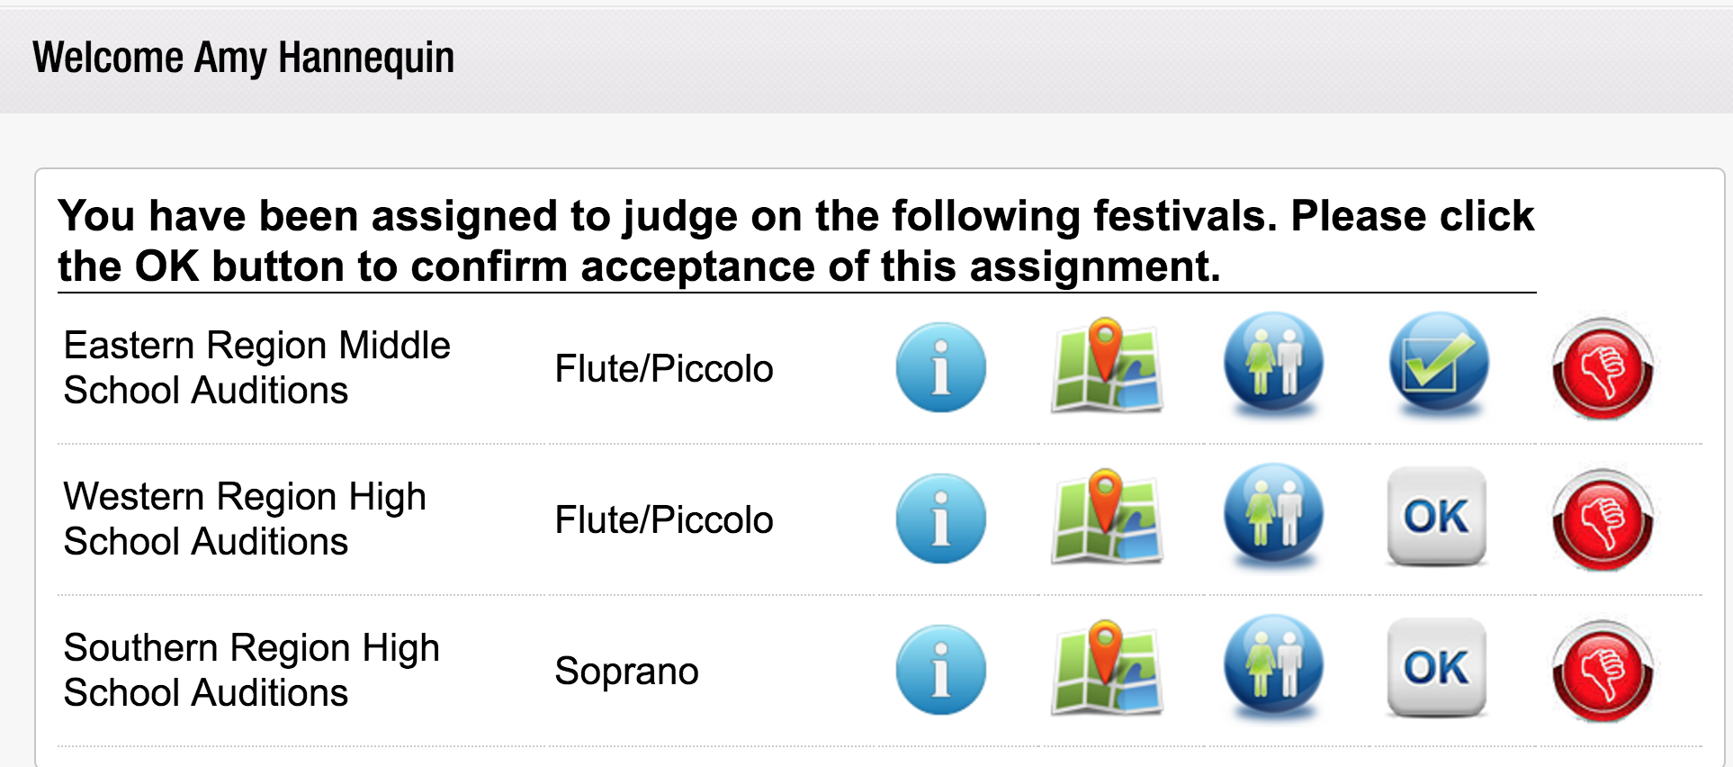
The female/male button is the button to retrieve students.

Slide 5
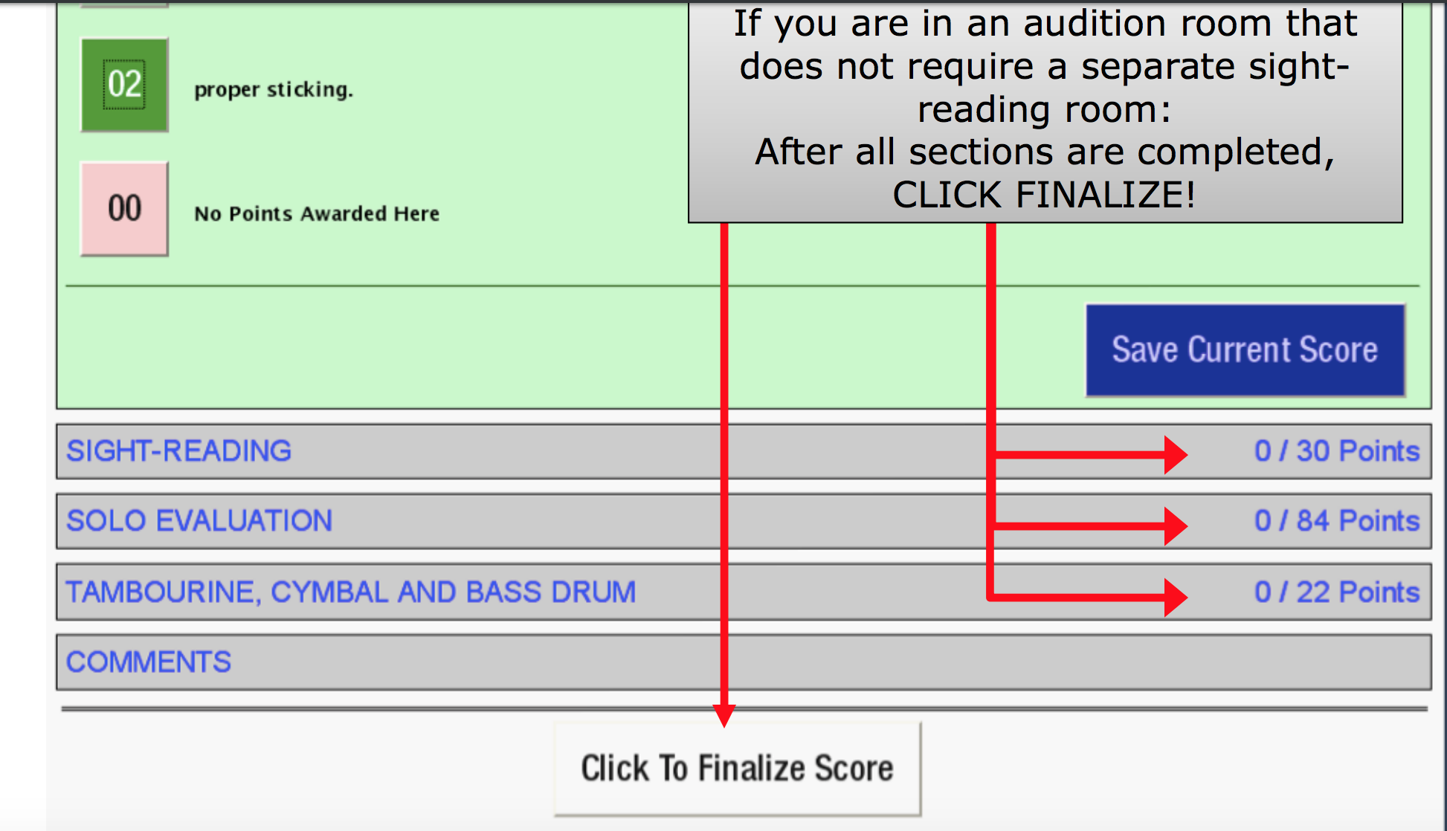

Slide 6
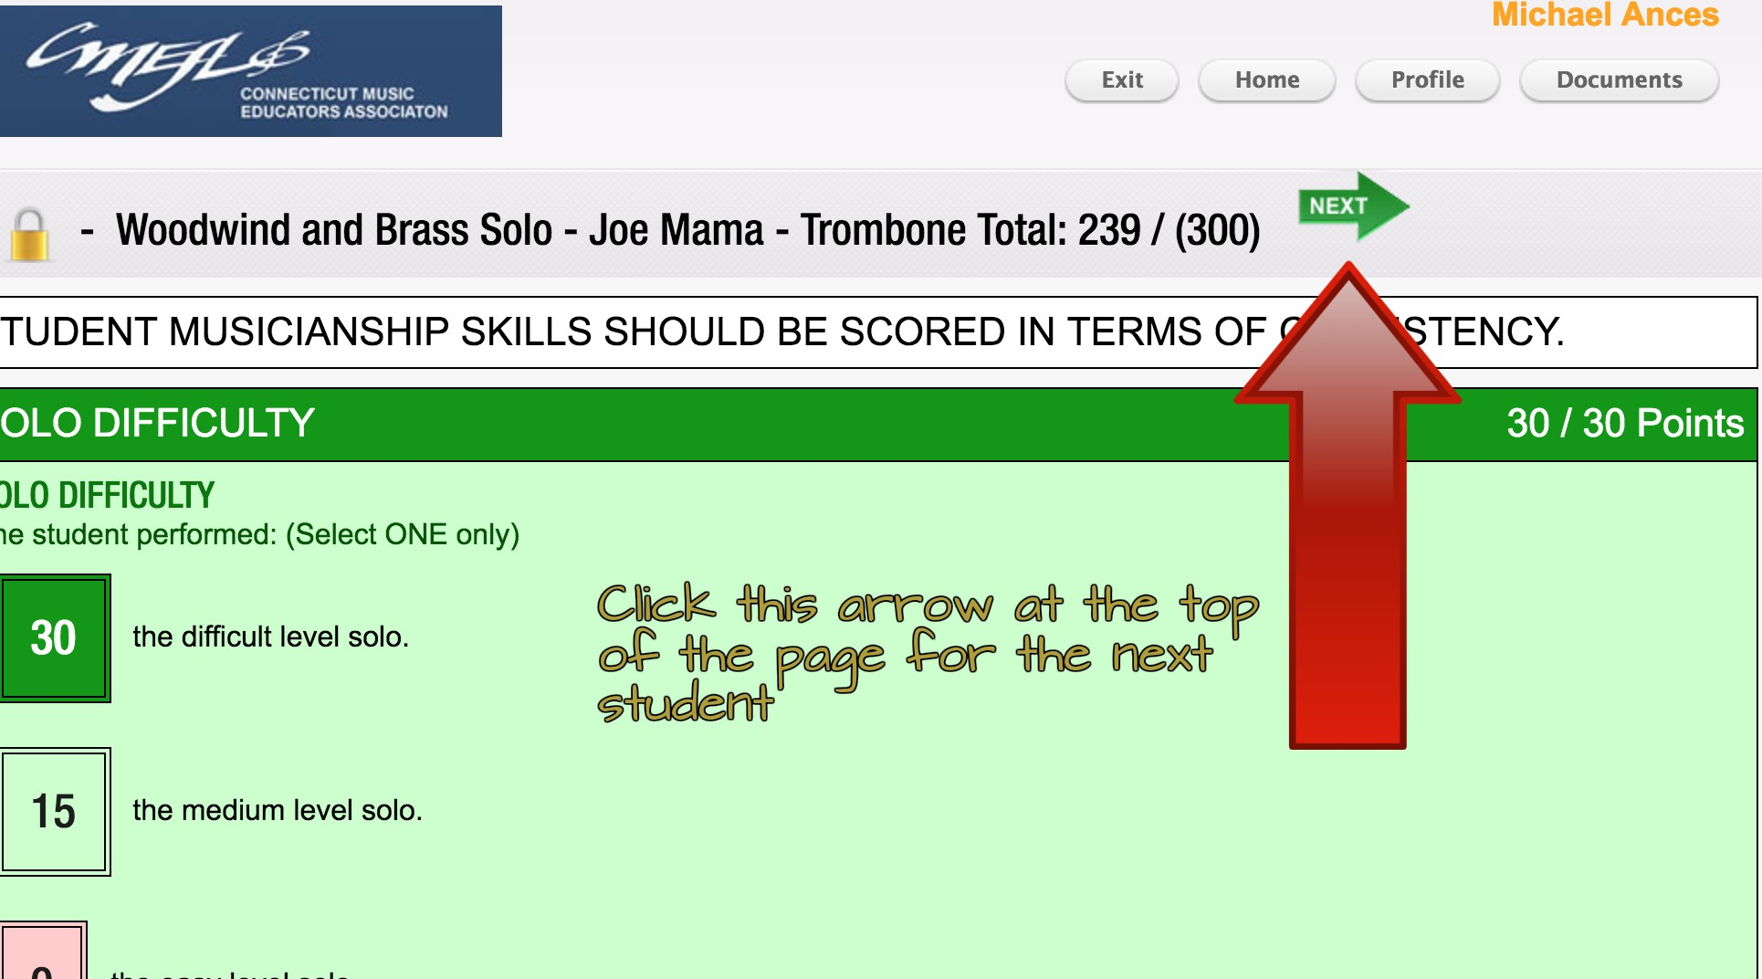
Or click “Home” above to view the entire student list

Slide 7
What is the role of the head judge?
Help with technology issues
Ensure that scores are being recorded correctly.
Clarify requirements and lead calibration of adjudicating during plenary.
Relay questions and concerns to the Judge Chairs, SAC Chair, or other Executive Board members at HQ
Fill in for judge if a known student, or one familiar is auditioning in room.

Slide 8
High School - Room lists – CTFest is the latest and most accurate; printed lists are not as updated. If possible, please update your printed room list to what CTFest is showing for your room. MS AND HS - Ask for student name before you start the audition!
Remember: MS auditions are untimed. This means the times in your ctfest lists are not accurate - ignore them. Students can show up at anytime for the audition today. Please try to limit each student to 10 -14 minutes to reduce long wait times for students. Confirm the student’s name before you start the audition!

Slide 9
Finalizing Option
With all audition areas, judges can delay “finalizing” until after the first few, so that a little comparing can be done to help with consistency of scoring for the rest of the day. Judges can re-open and adjust scores of previous students if scores are not yet finalizing.
Additional idea: after listening to the first student or two, have a judge swap with one judge in another room to share and equalize scoring ideas, then swap back; may improve consistency between rooms.
Head Judges can decide with you in your sessions

Slide 10
Expectations while judging:
ALL STUDENTS WHO ARE COMING TO AUDITION WILL BE HEARD.
Ask any questions immediately of head judges
Always click “Save Current Score”
Use all scratch sheets AND ctfest.net while adjudicating (one judge on each)
Please use the script provided. It is INAPPROPRIATE to give verbal feedback or a lesson/masterclass.
Stay on schedule! If students are available early (and are willing), please take them.
Confirm the student’s name and record the student’s name on the scratch sheet.
Be consistent and use the descriptors when adjudicating.

Slide 11
Judge Guidelines – first CHECK STUDENT NAME
Make students feel welcome and comfortable; no comments about instruments, dress, etc.
If a student has a different edition, he/she may still audition and be scored; however, the score must reflect the comparison to the proper edition (different articulation, different octaves, etc. result in lower scores).
Students with the wrong solo may play and receive comments, but not receive a score for the solo. They may play and be scored on the scales and sight-reading
Students performing from memory DO NOT need a copy of the music

Slide 12
Judge Guidelines: CMEA Copyright Policy
CMEA expects all students participating in the audition process to abide by all copyright laws. Students must have an original piece of music, a digitally purchased copy w/receipt, a public domain copy, OR perform from memory. With the exception of students performing from memory, students auditioning without an acceptable copy of music may be disqualified from festival participation.
STUDENTS PERFORMING FROM MEMORY DO NOT NEED A COPY OF THE MUSIC IN THE ROOM

Slide 13
Judge Copyright Guidelines
Unless performing from memory
(no music needed),
Confirm that student has original, or…
Confirm that student has a Public Domain copy, or...
* If student has a not-legal photocopy, student performs, is scored. This has NO effect on the student’s score. Make a note in the comments; keep a list of those who had illegal copies and inform Head Judge at the end of the day.
Do not send students out into the hall to find an original. This is not official protocol. SEE * ABOVE.

Slide 14
Judge Guidelines Continued
Be specific in comments such as “nice” tone, but be sure score reflects the comment. Try to avoid a generic comment like “good job” (unless it really was a good job!); use “thank you for your efforts”, etc. P-C-P: Prescriptive, Constructive, Prescriptive
Include written feedback on how to improve if appropriate.
Reminder – we do not listen to and/or score the cadenzas. Cadenzas are not part of the required solo.

Slide 15
Good example of Comments
Poor example of Comments
Excellent preparation for the audition! Your level of musicianship was demonstrated through your attention to the details of the solo. Continue to build flexibility between your registers through continued work on long tones and harmonics. Make sure to check the key signature prior to starting the sight-reading, however great rhythmic accuracy in the sight-reading!
Good job today. Make sure to practice note accuracy. Make sure to dress appropriately for an audition. Good job with scale.
Notes:
*Make sure that what you write in the comments reflects your scoring. If you scored something low, make sure to choose that when writing comments. This helps the student, teachers, and parents understand the scoring.

Slide 16
Judge Guidelines Continued
Respect Confidentiality – don’t ask where students are from or what school the are from, what kind of horn they play, do they have a private teacher, etc.
Be courteous, friendly, encouraging, but not too personal – best plan is to stay with the script as much as possible.
Please remember to guard the sight reading and remember that it is CMEA property – not yours to take, even after the auditions.
DO NOT photograph sight reading, post anything about auditions or materials on social media, or otherwise violate the sensitive nature of the process.
Do not talk about students within earshot of other students or teachers.
Positive and upbeat makes for a great day for everyone ☺

Slide 17
To Do at Your Collaborative Session
You will be meeting with the like instruments of your section and your Head Judges to calibrate adjudicating.
If deciding, choose the scales that you will hear for the day and tempo markings that are appropriate if not indicated. If time allows, the entire solo should be heard. (HS - All auditions are only 12 minutes)
If possible, listen to a section of the solo/a performance and practice adjudicating together. Make sure that all judges are adjudicating to the descriptors and to the same level.
Determine any tempos for sight reading (if not indicated), practice adjudicating through that as well.

Slide 18
Implicit Bias in Auditions
What is Implicit Bias?
Thought Processes That Happen Without You Even Knowing It.
Where Does it Come From?
Comes from Media Images, News Images, Conversations and Education that we are exposed to over the course of our lifetimes.
From: Implicit Bias: Peanut Butter, Jelly and Racism (https://www.pbs.org/video/pov-implicit-bias-peanut-butter-jelly-and-racism/)

Slide 19
Before You Leave/Sign Out Procedures:
Complete Online Honorarium Form at www.cmea.org Auditions/Festivals tab Adjudicator Honorarium in drop down menu
You must fill this out before leaving!
Check with Head Judge, and then Sign Out Area at HQ.
Filled out scratch sheets and solos will be collected separately. Place all other materials in the envelope.
The Festival Chair will collect materials at sign out HQ area.
THANK YOU for helping to make this a successful experience for our students!

